Slide 1
Unnecessary Hospital Readmissions Through Person-Centered Chronic Disease Care

Slide 2



Our Panelists
Tiffany Robinson, BSW
Training Specialist
ComForCare Franchise Systems, LLC
Colleen Toebe
Vice President of Clinical Services
Pathway Health

Slide 3
Course Objectives
Upon completion of each session, participants should be able to:
Identify common clinical and non-clinical drivers of avoidable hospital readmissions among older adults with chronic disease.
Apply person-centered strategies to support disease self-management and early symptom recognition.
Describe how tools such as INTERACT enhance communication and escalation across care settings.
Explain how in-home care programs can support care transitions and reduce rehospitalization risk.

Slide 4
The Human Impact of Unnecessary Hospitalization
Readmissions Why it Matters
Notes:
LISA
Before we talk about measures and penalties and how unnecessary hospitalization impact SNF and AL— let’s talk about the impact on our residents.
Older adults are extremely vulnerable in hospital environments.
Even short stays can cause:
Delirium
Deconditioning
Medication changes
This is not neutral. It is clinically risky.
I want to pause here and shift the lens.
We often talk about readmissions in terms of penalties, measures, and reimbursement.
But for a moment — let’s talk about the resident.
When an older adult is transferred unnecessarily, the risks can be significant.
LISA TO ASK COLLEEN: Colleen – can to walk us through some of the clinical impacts on residents related to unnecessary hospitalizations? What changes have you seen in residents after returning from the hospital?

Slide 5

Diagnosis – Medicare Hospitalizations
Common Drivers:
Septicemia
Heart Failure
Respiratory Infections
Kidney/UTI
Pulmonary Edema
Psychosis
Notes:
COLLEEN
Discuss
National data shows these are leading hospitalization diagnoses.
Notice how many are:
Chronic disease exacerbations
Infection-related
Often predictable
Weakened immune response Older adults may not show typical signs of infection (e.g., fever). Confusion or fatigue may be the first clue.
Common infections leading to hospitalization:
Urinary tract infections (UTIs)
Pneumonia
Sepsis These infections escalate rapidly if not recognized early.
Reduced cardiac reserve → increases risk of heart failure exacerbations and arrhythmias.
Decreased lung elasticity → makes pneumonia and COPD flare‑ups more severe.
Slower kidney filtration → increases risk of dehydration, electrolyte imbalance, and medication toxicity.
Impaired immune response → infections escalate faster and present atypically (e.g., confusion instead of fever).
Muscle loss (sarcopenia) → worsens mobility, increases fall risk, and slows recovery.

Slide 6
Early Identification of Change in Condition Matters
Early identification prevents:
Cognitive changes
Acute exacerbations of a condition
Sepsis progression
HF escalation
Respiratory failure
Crisis transfers
Psycho-social changes
Change in function
Regulatory deficiencies
Notes:
Colleen
Most hospitalizations don’t begin as emergencies.
They begin as subtle changes:
Increased fatigue
Slight confusion
Weight gain
Reduced appetite
When we catch change early — we intervene early.
When we miss it — we escalate into crisis.
Older adults experience several age‑related physical, cognitive, and social changes that significantly increase their risk of hospitalization. These changes often interact—mobility decline, chronic disease progression, and medication sensitivity can combine to create serious health events. Below is a clear, structured breakdown of the most common age‑related changes that lead to hospital admissions, supported by current evidence.
Delirium and dementia progression Cognitive impairment increases vulnerability to infections, medication side effects, and environmental stressors, often resulting in acute confusion that requires hospitalization.
Behavioral crises Anxiety, agitation, or wandering in dementia can escalate into emergencies when caregivers cannot manage symptoms at home
Mobility Decline & Increased Fall Risk
Balance, strength, and gait changes Age-related muscle loss and slower reflexes make falls more likely. Falls are the leading cause of injury-related hospitalizations in seniors.
Vision or hearing impairment Sensory decline contributes to missteps and accidents.
Polypharmacy (multiple medications) Older adults often take four or more medications daily, increasing the risk of adverse drug reactions (ADRs) and dangerous interactions. ADRs account for up to 30% of hospital admissions in older adults.
Medication mismanagement Confusion about dosing, duplicate prescriptions, or side effects can trigger hospital-level emergencies.

Slide 7

Septicemia- Early Warning Signs
General feeling of weakness and fatigue
Loss of appetite
A feeling of being cold or shivering
Not acting like themselves
Increased sleepiness
Notes:
Older adults often show atypical or muted symptoms, which makes early detection harder.
Often, families or caregiver may assume that “well they are getting old”.
Sudden Change in Mental Status
This is often the first and most important early sign in seniors.
Common changes:
New confusion
Disorientation
Agitation
Increased sleepiness
Elevated temperature or hypothermia,( VERY DANGEROUS)
The ability to provide early intervention prevents hospitalization
Not acting like themselves

Slide 8

Pneumonia-Early Warning Signs
Fatigue
Loss of appetite
Confusion
Dry cough
Notes:
Most types of pneumonia cause fever, cough with sputum (coughed-up mucus), shortness of breath and fatigue. In older patients, fatigue or confusion can be the only or most noticeable symptom. In viral pneumonia, a dry cough without sputum is more common.
Pneumonia can range in seriousness from mild to life-threatening. It is most serious for infants and young children, people older than age 65, and people with health problems or weakened immune systems.
Older adults (65+) may show different or milder symptoms, including:
Chest pain when you breathe or cough
Confusion or changes in mental awareness (in adults age 65 and older)
Cough, which may produce phlegm
Fatigue
Fever, sweating and shaking chills
Lower than normal body temperature (in adults older than age 65 and people with weak immune systems)
Nausea, vomiting or diarrhea
Pneumonia leads to over 1.5 million U.S. hospital admissions annually, with older adults representing the largest share.
And the risk of re-admission increases resulting with a re-admission within 30 days.
Shortness of breath

Slide 9
Potentially Preventable Readmission Diagnoses
High-Frequency Diagnoses:
Heart Failure
COPD
Pneumonia
Diabetes Complications
Sepsis
UTI
Kidney Disease
Stroke Complications
Mental Health Disorders
Substance Use Disorders
Notes:
COLLEEN
Discuss
These conditions drive significant readmissions nationally.
The key question: Are we building competency and pathways around these conditions?
“Across many facilities, we tend to see similar themes:
• CHF exacerbations • UTIs progressing to confusion • Pneumonia • Sepsis • New admissions transferring within 72 hours”
“These aren’t random events. They’re often predictable.”

Slide 10
Risk related to Hospitalization
59% developed hospital-associated complications including delirium, infection or falls
Older adults spend less than one-hour out of bed while hospitalized
Complications related to medication errors
Experience clinical depression
Higher rates of re-admission
Post-hospital syndrome
Notes:
The Oxford Academic published an article in Age and Ageing in 2024. They examined the rate of hospital associated complications in the older patients who are scheduled to return home.
Every year there are about 13.2 million hospitalizations for adults 65 years and older in the United States. Hospitalizations save lives, but there are many things that occur during the stay — and other hidden risks that can impact outcomes — especially for the older adult.
The effects of a hospitalization are exacerbated if someone is coming in with already limited mobility, because we know that a hospitalization itself puts us at risk of worsening mobility and functional impairments.
It’s common for older adults to actually develop a new impairment in activities of daily living that they didn’t have prior to a hospitalization.
Post-hospital syndrome is a transient period of generalized health vulnerability following an acute hospital admission. This syndrome involves physiologic deconditioning due to various stressors that are experienced during the hospital stay, such as disrupting the circadian rhythms, nutritional depletion, and just the physical and psychological stress of the hospital environment itself.

Slide 11

Potential Impact of Hospitalizations
Unnecessary hospitalizations can lead to:
Delirium and cognitive decline
Hospital acquired infections
Pressure injuries
Functional decline
Deconditioning
Medication complications
Emotional distress and anxiety
Increased mortality risk
Notes:
Colleen
(Discuss the areas indicated and others that you have seen )
Hospital environments increase:
Delirium
Immobility
Falls
Medication changes
Infections”
Even a short hospitalization can permanently impact function.
hospitalization
Older adults are at a higher risk for hospitalization due to various health conditions and complications. Common reasons for hospitalization include:
Severe acute illnesses: Such as sepsis and cardiovascular disease, which are leading diagnoses for medical admissions among older patients.
1
Chronic conditions: Older adults often have multiple chronic illnesses that require hospitalization, leading to increased healthcare utilization.
1
Functional decline: A significant decline in activities of daily living (ADLs) can occur after hospitalization, particularly in frail older adults.
1
Medication side effects: Medication management can be complex for older adults, leading to adverse events and hospitalizations.
1
Hospital-acquired infections: These can occur during hospitalization and contribute to the risk of preventable hospitalizations.
1
These factors highlight the importance of age-appropriate healthcare management and the need for specialized care in older adults to reduce the risk of hospitalization and improve outcomes.

Slide 12
Potential Impact of Hospitalizations
Hospital transfers disrupt:
Routine and environment
Familiar care givers
Medication stability
Sleep cycles
Emotion and reactions
Care continuity
Confidence, trust
Older adults are vulnerable to:
Post hospital syndrome – high risk for complications
Functional loss
Loss of independence
Notes:
Lisa
what other ways to transfers to hospitals or the ED impact the individuals that live in our settings?”
Its not just clinical impacts, there are other impacts on our residents.
Residents thrive on consistency.
Hospital transfers disrupt everything — physically and emotionally.
Older adults thrive on routine and stability.
When we transfer them, we disrupt everything:
Their routine
Their familiar caregivers
Their medication consistency”
“There’s also something called post-hospital syndrome — a period of vulnerability following discharge where residents are at higher risk for complications.”
“This is why preventing avoidable transfers is about safety — not just savings.
LISA TO ASK BETTY – Looking at and understanding the impact of unnecessary hospitalizations outlined by Colleen and Betty is key for all of us as leaders. Does this impact how we identify change in condition of a resident? Is early identification Key Betty?

Slide 13
Respiratory Assessment
Inspection
Auscultation
Percussion
Palpation
Accurate vital signs
Laboratory test interpretation
Pulse oximetry
Notes:
nurses must be able to perform a complete, accurate respiratory exam.
Skills include:
Inspection:
Work of breathing
Use of accessory muscles
Chest expansion
Respiratory rate and pattern
Auscultation:
Crackles (rales)
Rhonchi
Wheezes
Diminished breath sounds
Percussion:
Dullness over consolidated lung areas
Palpation:
Increased tactile fremitus

Slide 14

Accurate History
Onset and duration of cough, fever,
Recent exposure
Vaccination
Medication
Any early recognition
Capability of clinical decision making
Notes:
Prioritize airway, breathing, circulation
Administer oxygen safely
Encourage deep breathing, coughing, and incentive spirometry
Hydrate the patient (as appropriate)
Collaborate with respiratory therapy
Monitor response to antibiotics
Nurses must detect early signs of worsening pneumonia:
Hypoxia
Sepsis
Respiratory failure
Dehydration
Pleural effusion

Slide 15
Person-Centered Care
Notes:
A person‑centered assessment begins with exploring an individual’s understanding of their condition, their personal preferences, and the goals that matter most to them. This involves creating a supportive environment where the older adult feels comfortable expressing what they know, what worries them, and what they hope to achieve in managing their health. Rather than assuming knowledge or imposing standardized plans, the nurse actively listens, asks open‑ended questions, and clarifies misconceptions in a respectful way. Understanding the person’s cultural background, daily routines, values, and desired level of independence helps tailor care strategies that feel realistic and meaningful. By aligning health interventions with the individual’s priorities—whether maintaining mobility, reducing symptoms, or staying at home—the nurse empowers the older adult to take an active role in their self‑management and strengthens their confidence in navigating their condition.

Slide 16
Understanding-Goals and Preferences
Make sure communication is simple, clear and culturally sensitive
Explore the understanding of the condition
Tailor education to the learning style
Assess for deficits with hearing and vision
Notes:
Older adults vary in what they need or want to manage. The key steps is first do complete a comprehensive assessment on what the ability to manage a specific disease state.
Ask what they want to focus on
Explore their understanding of the condition
Identify what matters most (e.g., staying independent, reducing pain, avoiding hospitalization)
Tailor education to their learning style (visual, verbal, hands‑on)
Older adults who speak English as a second language often face unique challenges in understanding health care information, which can affect their ability to navigate the system and manage chronic conditions. Limited English proficiency may make it difficult to interpret medical terminology, follow treatment instructions, or communicate symptoms clearly, leading to misunderstandings and reduced confidence in decision‑making. Many older adults may also feel hesitant to ask questions or admit confusion, especially if cultural norms discourage challenging authority figures. Person‑centered care requires recognizing these barriers and adapting communication through plain language, visual aids, interpreters, and culturally respectful dialogue. By creating a supportive environment where older adults feel heard and understood, health professionals can strengthen comprehension, promote shared decision‑making, and empower individuals to participate actively in their own care.

Slide 17

Relevant Education
Break information into small steps
Link information to daily routines
Large print
Plain language
Repeat instructions
Notes:
Using plain language is essential when teaching older adults about their health, as it helps ensure information is clear, accessible, and not overwhelming. Nurses can support understanding by breaking information into small, manageable steps and checking comprehension through the teach‑back method, inviting the person to demonstrate or explain instructions in their own words. Providing written or visual aids with large print reinforces learning and accommodates age‑related changes in vision or memory. Linking new information to the person’s daily routines—such as taking medication with breakfast or checking symptoms before bedtime—helps make self‑management feel natural and achievable. When education is delivered in a way that feels empowering rather than intimidating, older adults are more confident and engaged in managing their own health.

Slide 18
Adapt to Functional and Cognitive Abilities
Easy to read pill bottles
Modify home environment
Provide adaptive equipment
Use repetition and routines, visual aids
Keep instructions short and concise
Always support dignity

Slide 19
Strengthen Social Support
Involve family, friends or community support
Provide realistic healthy lifestyle behaviors
Nutritional support, access to food and respect for cultural foods
Sleep hygiene
Smoking cessation
Assessment of substance use disorder
Notes:
Good sleep hygiene is essential for older adults, yet aging often brings changes that make restful sleep harder to achieve. Establishing healthy sleep habits—such as keeping a consistent bedtime, creating a quiet and comfortable sleep environment, limiting daytime naps, and avoiding caffeine or heavy meals late in the day—helps regulate the body’s internal clock and supports deeper, more restorative sleep. Gentle evening routines like reading, stretching, or listening to calming music can also signal the body that it’s time to wind down. For many older adults, reducing screen time before bed and ensuring exposure to natural daylight during the day can improve sleep quality by supporting healthy circadian rhythms.
Quality sleep plays a powerful role in overall health. Poor sleep in older adults is linked to increased risk of falls, impaired memory, reduced immune function, mood changes, and worsening of chronic conditions such as heart disease, diabetes, and depression. It can also affect balance, reaction time, and daytime alertness, making everyday activities more challenging. By prioritizing sleep hygiene, older adults can improve their energy levels, cognitive function, emotional well‑being, and overall quality of life. In short, better sleep isn’t just about feeling rested—it’s a cornerstone of healthy aging.

Slide 20

English as a Second Language
Clear, simple and culturally sensitive communication
Incorporate interpreters and bilingual resources
Visual, hands-on teaching methods
Build trust through respect, patience and cultural awareness
Notes:
Older adults who speak English as a second language often face unique challenges in understanding health care information, which can affect their ability to navigate the system and manage chronic conditions. Limited English proficiency may make it difficult to interpret medical terminology, follow treatment instructions, or communicate symptoms clearly, leading to misunderstandings and reduced confidence in decision‑making. Many older adults may also feel hesitant to ask questions or admit confusion, especially if cultural norms discourage challenging authority figures. Person‑centered care requires recognizing these barriers and adapting communication through plain language, visual aids, interpreters, and culturally respectful dialogue. By creating a supportive environment where older adults feel heard and understood, health professionals can strengthen comprehension, promote shared decision‑making, and empower individuals to participate actively in their own care.
Nurses take time to learn about the person’s cultural background, health beliefs, and preferred decision‑making style. By showing patience, listening actively, and validating the person’s experiences, nurses create a safe environment where ESL older adults feel comfortable asking questions and participating in their care.

Slide 21

Proactive – INTERACT
Readmissions Proactive
Notes:
LISA
Available to all SNF, AL and Home Care is an evidenced based proactive quality improvement program called INTERACT.
What is INTERACT?
INTERACT is an acronym for “Interventions to Reduce Acute Care Transfers.” The interventions is a quality improvement program designed to improve the identification, evaluation, and communication about changes in resident status. INTERACT was first designed in a project supported by the Centers for Medicare and Medicaid Services (CMS). Now, many post-acute providers across the U.S. are using INTERACT.
What is the purpose of the INTERACT Quality Improvement Program?
The overall goal of the INTERACT program is to reduce the frequency of transfers to the acute hospital. As we discussed, Transfers to the hospital can be emotionally and physically difficult for residents, and result in numerous complications of hospitalization, and they are costly.
LISA TO ASK BETTY: BETTY, would you tell us a little more about the INTERACT Quality Improvement Program?

Slide 22

Acronym
(Interventions to Reduce Acute Care Transfers)
Includes
Clinical tools
Educational Tools
Strategies
Quality Improvement Program
Focus
Management of acute change in resident condition
Notes:
Lisa
There are four basic types of tools:
Quality Improvement tools
Communication tools
Decision Support tools
Advance Care Planning tools
The specific tools are designed for use by selected members of the care team. However, in order for the INTERACT team to be successful, all members of the care team should be aware of all of the tools and their uses.

Slide 23
INTERACT
Is not a “tool”
Is no longer a “toolkit”
INTERACT 4.5 - All other versions are not supported
INTERACT IS a QI Program
The goal of INTERACT is to improve care, not to prevent all hospital transfers
In fact, INTERACT can help with more rapid transfer of residents who need hospital care
Notes:
Lisa
“I want to reframe something: INTERACT is not just a set of forms.
It’s a leadership system.”
“It creates consistency in how change of condition is recognized, escalated, and managed.”
“Consistency reduces uncertainty. And uncertainty drives transfers.”

Slide 24

Advanced Care Planning Tools
Communication Tools
Decision Support Tools
Quality Improvement Tools
Notes:
Lisa

Slide 25
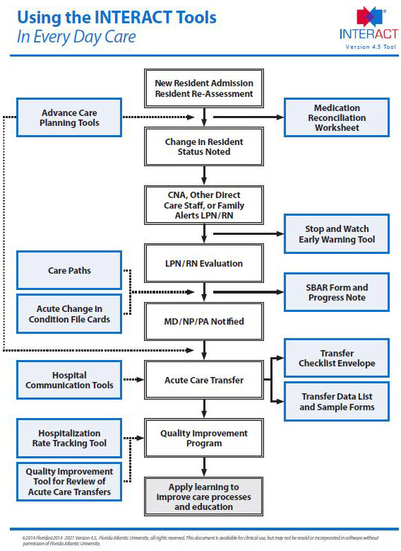
The INTERACT Tools are meant to be used together in your daily work
Notes:
Lisa
Discuss how the tools work together – part of a quality improvement process – for AL, SNF and Home Care
Blue box are tools
Middle portion is the admission through stay to DC process
The algorithm show you when and where to use them.

Slide 26
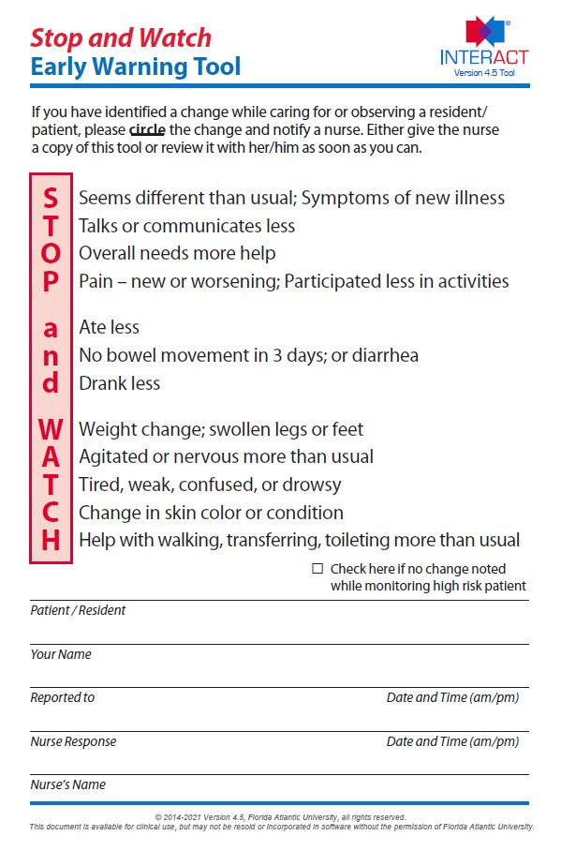
Common Tools
Communication Tool
Notes:
Lisa
this is a tool that most people know and is pivotal for the early identification of CoC.
One of the most important tools in the QIP. Early identification of subtle changes in condition.
“Most changes are first noticed by CNAs.
Not nurses. Not physicians.”
“Stop & Watch gives CNAs language. And language creates confidence.”
Colleen, would you discuss a few more of the tools that are utilized in this process?

Slide 27
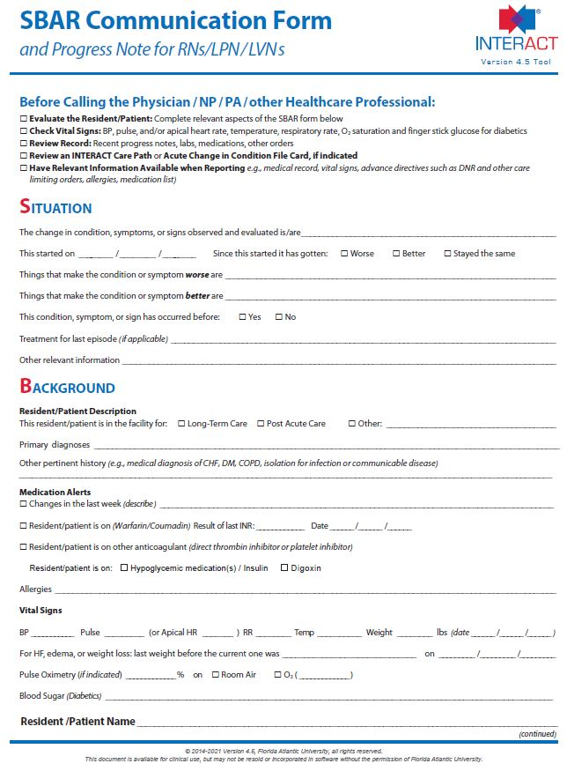
Common Tools
Communication Tool Category
Notes:
COLLEEN
The Purpose of the SBAR
Improve communication
Consistent language
Standardized criteria
Clear guidelines
Communication that is efficient
Communication that is effective
“Let’s talk about provider calls.
Have you ever listened to a nurse call a physician and thought — ‘That could have been clearer’?”
SBAR transforms that conversation from: ‘Mrs. Smith isn’t doing well’
To: ‘Here is the situation, here is my assessment, here is what I recommend.’”
🧩 What SBAR Stands For
🟦 S — Situation
A brief statement of the immediate issue.
Example: “The patient is experiencing sudden shortness of breath.”
🟨 B — Background
Relevant context or history that helps explain the situation.
Example: “They were admitted yesterday with pneumonia and have a history of COPD.”
🟩 A — Assessment
Your professional evaluation of the problem.
Example: “Respiratory rate is increasing, oxygen saturation is dropping.”
🟥 R — Recommendation
What you think should happen next.
Example: “I recommend increasing oxygen support and requesting a respiratory consult.”
🏥 Why SBAR Matters
Enhances clarity and reduces miscommunication.
Saves time during urgent situations.
Standardizes communication across teams.
Originally developed by the U.S. Navy for submarine operations and later adopted widely in healthcare.
📋 Quick SBAR Example (Nursing)
S: “I’m calling about Mr. Lee in Room 204 who is complaining of chest pain.” B: “He had cardiac surgery two days ago and has been stable until now.” A: “Pain is 8/10, BP is dropping, and he looks pale.” R: “I recommend evaluating him immediately and ordering an ECG.”

Slide 28
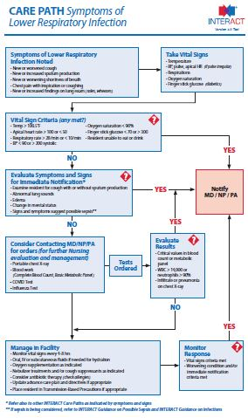
Common Tools
Decision Support Tool – Care Paths
Acute Mental Status Change
Change in Behavior: New or Worsening Behavioral Symptoms
Dehydration
Fall
Fever
GI Symptoms
Symptoms of Shortness of Breath (SOB)
Symptoms of CHF
Symptoms of Lower Respiratory Illness
Symptoms of UTI
Notes:
COLLEEN
Work in conjunction with SBAR – Decision support tool and assists with SBAR process.
“One reason nurses transfer is they aren’t confident managing in place.
Care paths reduce variability.”
“They clarify: • What to monitor • When to escalate • When transfer is appropriate”
Older adults experience changes in condition very differently from younger adults because aging alters how the body responds to illness, stress, and injury. These changes often make symptoms subtle, atypical, or slower to appear, which can delay recognition of serious problems.
Infections may not cause fever because baseline temperature is lower and immune response is weaker.
Pain may be less pronounced, even in serious conditions.
Confusion, falls, or decreased appetite may be the first sign of illness (e.g., UTI, pneumonia).
⚡ Younger adults
Typically show classic, strong symptoms (fever, pain, inflammation).
Body mounts a faster, more robust immune response.
❤️ 2. Physiological Differences That Affect Condition Changes
🫀 Vital signs
Older adults:
Lower baseline temperature
Higher baseline blood pressure due to arterial stiffness
Orthostatic hypotension is common
Slightly higher respiratory rate
Lower oxygen saturation
Younger adults:
Vital signs stay within narrow, predictable ranges
Rapid compensation during illness
🧬 Immune system
Older adults: Immune response is slower and weaker → infections progress faster and present subtly.
Younger adults: Stronger immune response → quicker, more obvious symptoms.
🧓 3. Cognitive and Functional Changes
🧩 Older adults
Slower reaction times, reduced short-term memory, and slower information processing.
Illness may first appear as:
Confusion
Withdrawal
Reduced mobility
Increased falls
🧑‍🦱 Younger adults
Cognitive function is stable; illness rarely causes acute confusion unless severe.
💪 4. Chronic Conditions & Polypharmacy
🧓 Older adults
92% have at least one chronic condition; 77% have two or more.
Medications can mask symptoms or interact, making changes harder to detect.
Baseline health is more fragile → small changes can have big impacts.
🧑‍🦱 Younger adults
Fewer chronic conditions
Less medication use
Body compensates more effectively
🩺 5. Recovery and Response to Stress
🧓 Older adults
Slower healing and recovery
Less physiological reserve (heart, lungs, kidneys)
More sensitive to dehydration, temperature changes, and medication side effects
🧑‍🦱 Younger adults
Faster recovery
Greater resilience to stressors
More predictable response to treatment

Slide 29
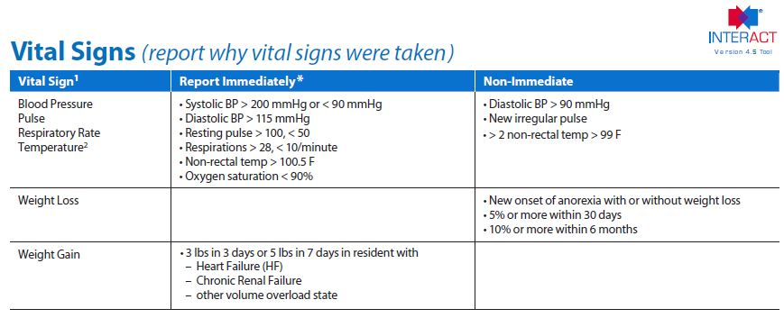
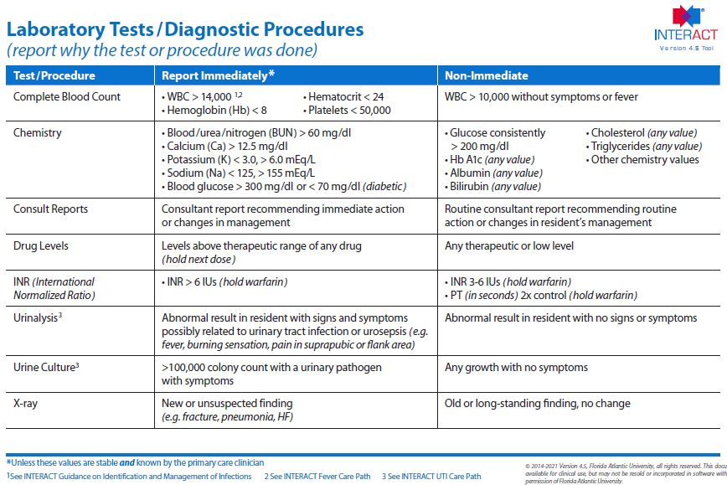
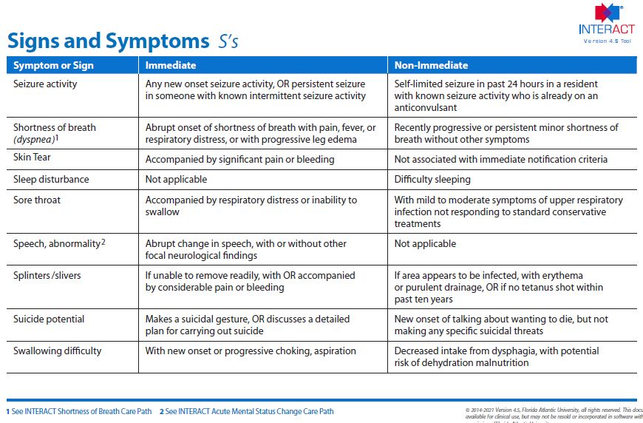
Common Tools - CoC File Cards
Notes:
COLLEEN
Work in conjunction with Care Paths, SBAR – decision support tool

Slide 30
Many other tools - INTERACT
Admission
Advance Care Planning tools
Medication Reconciliation
Communication
Stop and Watch
SBAR
Hospital Communication
Capabilities Checklist
D/C Tool
Transfer Checklist
Transfer Data List
Decision Support
Care Paths
Acute CoC File Cards
Quality Improvement
Hospital Rate Tracking Tool
QI Tool for Review of Acute Care Transfers
Notes:
Colleen – DISCUSS

Slide 31
Access INTERACT
Includes evidence and expert-recommended clinical practice tools, strategies to implement them, and related educational resources
The basic program is located on the internet: http://www.pathway-interact.com

Slide 32

Reviewing Transfers
After every transfer ask:
Was this preventable?
Was recognition timely?
Was documentation complete?
Notes:
Lisa
DISCUSS = for leaders to remember
This is about system learning — not blame.
“If a resident transfers out, that should trigger learning — not blame.”
Ask: “What could we have recognized sooner?” “Was the documentation clear?” “Were orders delayed?”

Slide 33

Leadership Ownership
Leaders:
Review data monthly
Standardize expectations
Audit documentation
Engage providers
Engage staff
Incorporate INTERACT in your day-to-day processes!

Slide 34
Staff Training for Care Transitions and Reducing Rehospitalization Risk

Slide 35

Foster a Culture of Person-Centered Care
Training to Support Safe Care Transitions to Home
Build shared accountability for successful care transitions by embedding person-centered care principles into onboarding and ongoing education, reinforcing that every team member plays a role in preventing avoidable rehospitalizations.
Align person-centered care training so staff understand not only what actions to take during transitions, but why individualized planning, communication, and relationship-centered practices matter for clients, families, and interdisciplinary teams.
Use practical, real-world care transition scenarios to help staff confidently apply person-centered approaches in daily practice (e.g., recognizing subtle changes in condition, honoring client preferences, and ensuring clear handoffs across settings).
Strengthen competency through interdisciplinary case reviews, and timely feedback, supporting staff in identifying early warning signs, escalating concerns appropriately to reduce risk of complications and unnecessary hospital readmissions.
Co-design training with input from frontline caregivers, clinical leaders, and care partners to ensure content reflects real workflows, common transition gaps, and value-based care expectations, ultimately creating smoother transitions and safer outcomes for those served.
Notes:
Tiffany

Slide 36

Strengthening Care Transitions
Training with Collaborative Partners
Foster shared accountability by aligning transition-of-care education across partners, ensuring leaders and staff understand how every discipline contributes to safe discharges, continuity of care, and prevention of avoidable readmissions.
Use Interdisciplinary training to reinforce the why behind coordinated care transition practices, supporting clear communication, consistent messaging, and early identification of changes in condition across providers and settings.
Leverage technology to deliver standardized, evidence-based education and real-time updates across partner organizations (e.g., virtual training platforms, digital communication tools that close gaps during handoffs).
Co-develop shared care protocols, escalation pathways, and risk-stratification strategies through collaborative training sessions that support rapid response to post-discharge concerns.
Promote a unified person-centered transition-to-home approach that respects each partner’s role, reduces fragmentation and duplication, and strengthens collective responsibility for care outcomes, and safer recovery at home.
Notes:
Tiffany

Slide 37

Training In Action – Care Transitions in Practice
Client/Patient Example:
Client condition
Client situation
Client impact
Support tools utilized
Professional Care Team Training:
How is training provided?
How are skills tested/maintained?
What is gained in a long-term program?
Notes:
Tiffany

Slide 38
Helpful Resources
The Centers for Medicare and Medicaid Services (CMS) HHRP (Hospital Readmission Reduction Program
Hospital Readmissions Reduction Program
CMS – Skilled Nursing Facility Value Based Purchasing Program
CMS SNFVBP Confidential Feedback Reports
CMS SNF VBP Frequently Asked Questions
Skilled Nursing Facility Within-Stay Potentially Preventable Readmission (SNF WS PPR) Measure for the Skilled Nursing Facility Value-Based Purchasing (SNF VBP) Program
AHRQ Hospital Guide to Reducing Medicaid Readmissions
Quality Improvement Organizations
The risks of hospital stays: A guide to safe recovery and returning home for older adults (Mayo Clinic)
Pneumonia - Symptoms and causes (Mayo Clinic)
Reducing Hospital Readmissions (ComForCare)

Slide 39
Our Panelists
Tiffany Robinson, BSW
Training Specialist
ComForCare Franchise Systems, LLC
Colleen Toebe
Vice President of Clinical Services
Pathway Health

Slide 40
Disclaimer
“This presentation provided is copyrighted information of Pathway Health and ComForCare Franchise Systems, LLC. Please note the presentation date on the title page in relation to the need to verify any new updates and resources that were listed in this presentation. This presentation is intended to be informational. The information does not constitute either legal or professional consultation. This presentation is not to be sold or reused without written authorization.”

